Slide 2
solve problems based on arithmetic and geometric progression.

Slide 3

Problem 1
Is the sequence given by $T_{n}$= 12n - 9 form an A. P.?
$T_{n}$= 12n - 9
$T_{n −1}$ = 12(n-1) - 9
$T_{n −1}$= 12n – 12 - 9
$T_{n −1}$= 12n - 21
$T_{n}$ - $T_{n −1}$ = (12n - 9) – (12n – 21)
= 12n - 9 – 12n + 21
= 12

Slide 4

Problem 2
Find the 15th term of the sequence 12, 7, 2, - 3, - 8, ....
First term = a = 12
Common Difference = d = - 5
n = 15
$T_{n}$ = a + (n - 1) d
$T_{15}$ = 12 + (15 - 1) (-5)
$T_{15}$ = 12 – 70
$T_{15}$ = - 58

Slide 5
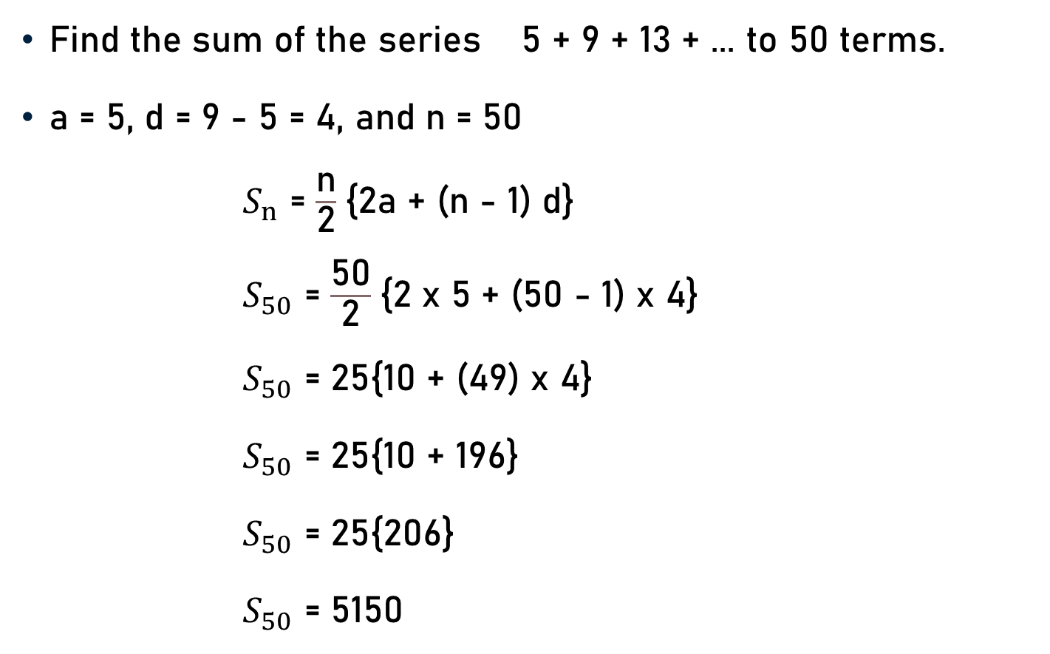
Problem 3
Find the sum of the series 5 + 9 + 13 + ... to 50 terms.
a = 5, d = 9 - 5 = 4, and n = 50
$S_{n}$ = $\frac{\text{n}}{\text{2}}${2a + (n - 1) d}
$S_{50}$ = $\frac{\text{50}}{\text{2}}${2 x 5 + (50 - 1) x 4}
$S_{50}$ = 25{10 + (49) x 4}
$S_{50}$ = 25{10 + 196}
$S_{50}$ = 25{206}
$S_{50}$ = 5150

Slide 6
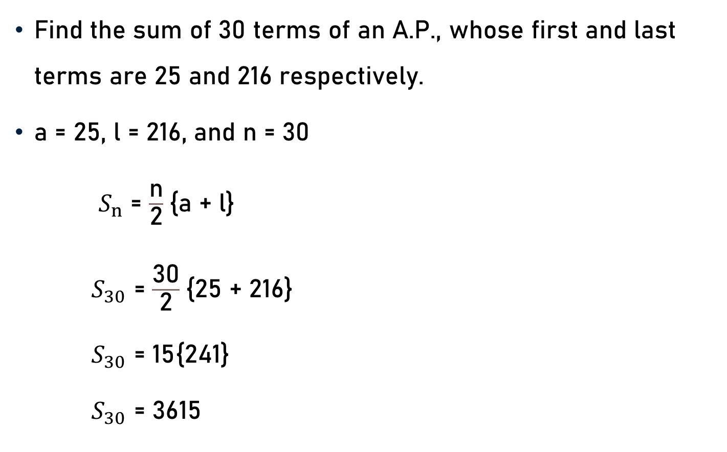
Problem 4
Find the sum of 30 terms of an A.P., whose first and last terms are 25 and 216 respectively.
a = 25, l = 216, and n = 30
$S_{n}$ = $\frac{\text{n}}{\text{2}}${a + l}
$S_{30}$ = $\frac{\text{30}}{\text{2}}${25 + 216}
$S_{30}$ =$\text{ 15}${241}
$S_{30}$ =$\text{361}\text{5}$

Slide 7
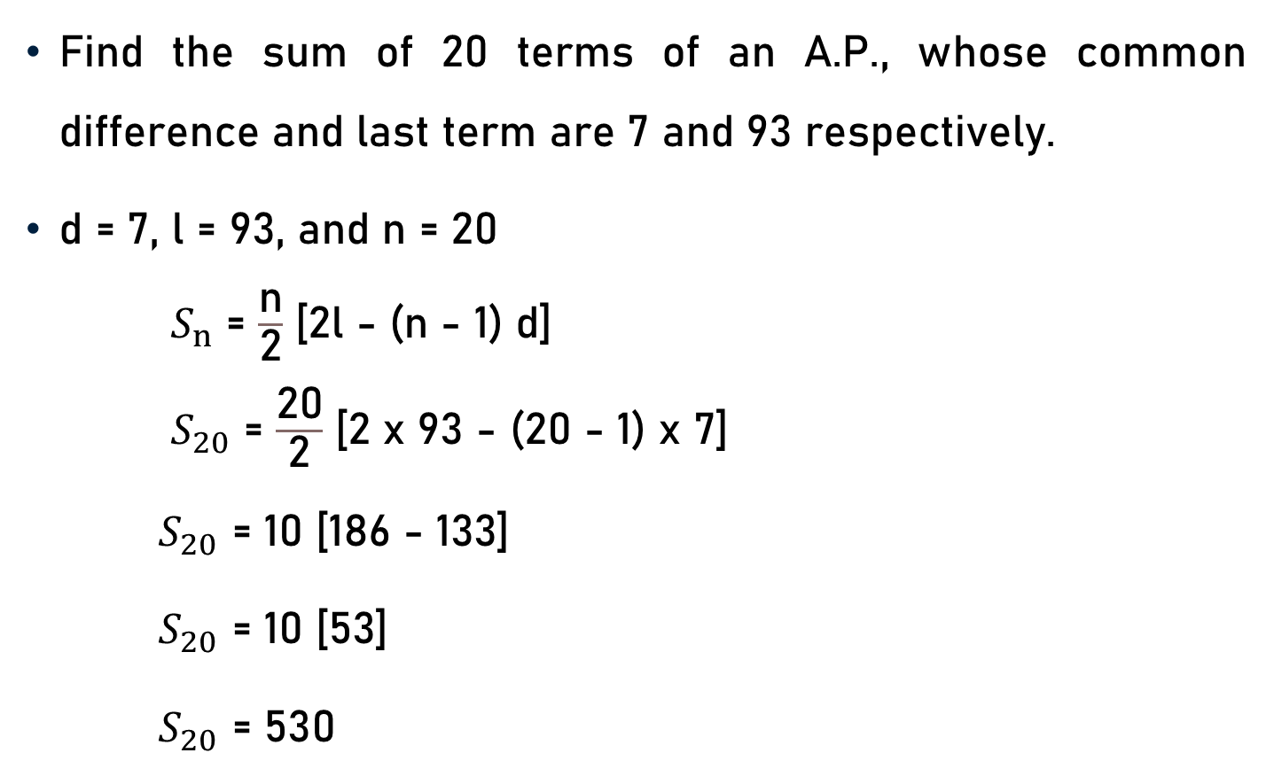
Problem 5
Find the sum of 20 terms of an A.P., whose common difference and last term are 7 and 93 respectively.
d = 7, l = 93, and n = 20
$S_{n}$ = $\frac{\text{n}}{\text{2}}$ [2l - (n - 1) d]
$S_{20}$ = $\frac{\text{20}}{\text{2}}$ [2 x 93 - (20 - 1) x 7]
$S_{20}$ =$\text{ 10}$ [186 - 133]
$S_{20}$ =$\text{ 10}$ [53]
$S_{20}$ =$\text{5}\text{30}$

Slide 8
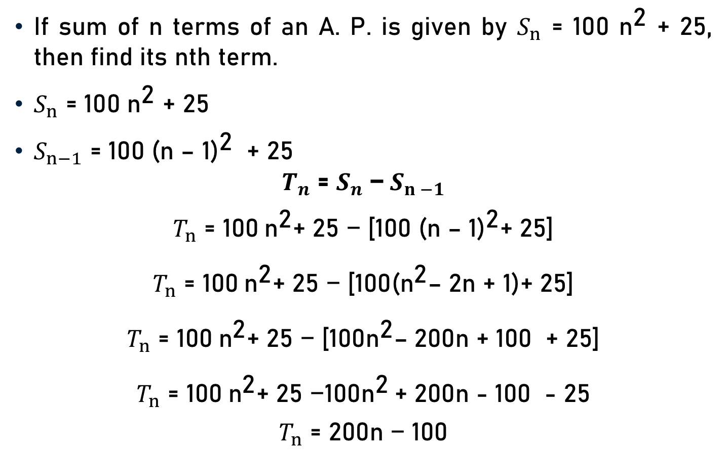
Problem 6
If sum of n terms of an A. P. is given by $S_{n}$ = 100 ${\text{n}}^{\text{2}}$ + 25, then find its nth term.
$S_{n}$ = 100 ${\text{n}}^{\text{2}}$ + 25
$S_{n−1}$ = 100 ${\text{(}\text{n}\text{ – 1)}}^{\text{2}}$ + 25
$$T_{n}\text{ = }S_{n} \text{−}{ S}_{n −1}$$
$$T_{n}\text{ =} \text{100}{ \text{n}}^{\text{2}}\text{+ 25} \text{−}\text{ [}\text{100} {\text{(}\text{n}\text{ – 1)}}^{\text{2}}\text{+ 25}\text{]}$$
$$T_{n}\text{ = 100}{ \text{n}}^{\text{2}}\text{+ 25 − [100}{\text{(}\text{n}}^{\text{2}}\text{–}\text{ 2}\text{n}\text{ + 1)}\text{+ 25]}$$
$$T_{n}\text{ = 100}{ \text{n}}^{\text{2}}\text{+ 25 − [100}{\text{n}}^{\text{2}}\text{– }\text{200}\text{n}\text{ + 100 + 25]}$$
$$T_{n}\text{ =} \text{100}{ \text{n}}^{\text{2}}\text{+ 25} \text{−100}{\text{n}}^{\text{2}} \text{+}\text{ 200}\text{n}\text{ − 100 − 25}$$
$$T_{n}\text{ = 200}\text{n}\text{ − 100}$$

Slide 9
Problem 7
Determine x so that x + 2, 4x - 6 and 3x - 2 are the three consecutive terms of an A.P.
Three numbers a, b, c are in A.P. iff b - a = c - b iff a + c = 2b
x + 2, 4x – 6, and 3x – 2
a b c
x + 2 + 3x – 2 = 2(4x – 6)
4x = 8x – 12
12 = 8x – 4x

Slide 10
Problem 7
12 = 8x – 4x
4x = 12
x = 3
Three consecutive terms are x + 2, 4x - 6 and 3x – 2
i.e., 3 + 2, 4(3) - 6 and 3(3) – 2
i.e., 5, 6 and 7
3

Slide 11
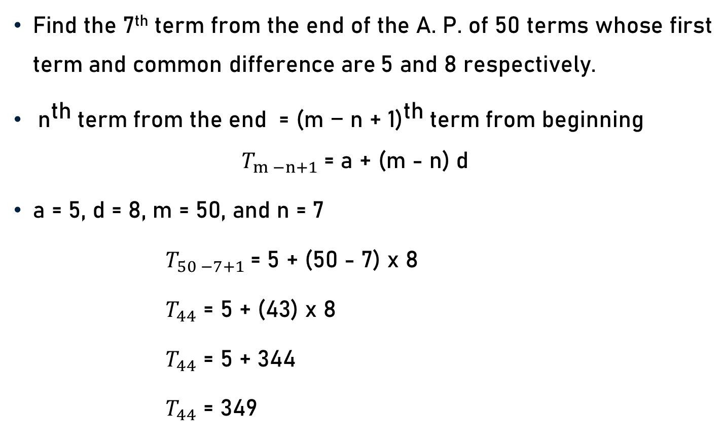
Problem 8
Find the 7th term from the end of the A. P. of 50 terms whose first term and common difference are 5 and 8 respectively.
${ \text{n}}^{\text{th}}$term from the end = ${\text{(}\text{m}\text{ − }\text{n}\text{ + 1)}}^{\text{th}}$term from beginning $T_{m −n+1}$= a + (m - n) d
a = 5, d = 8, m = 50, and n = 7
$T_{50 −7+1}$= 5 + (50 - 7) x 8
$T_{44}$ = 5 + (43) x 8
$T_{44}$ = 5 + 344
$T_{44}$ = 349

Slide 12

Problem 9
Is the sequence 3, -6, 12, -24, ……. form a G. P.?
$T_{1}$= 3, $T_{2}$= -6, $T_{3}$= 12, $T_{4}$= -24, $T_{5}$= 48, ….
$\frac{T_{2}}{T_{1}}$ = $\frac{\text{−6}}{\text{3}}$ = -2
$\frac{T_{3}}{T_{2}}$ = $\frac{\text{12}}{\text{−6}}$ = -2
$\frac{T_{4}}{T_{3}}$ = $\frac{\text{−}\text{24}}{\text{12}}$ = -2
$\frac{T_{2}}{T_{1}}$ = $\frac{T_{3}}{T_{2}}$ = $\frac{T_{4}}{T_{3}}$ = -2 (G.P.)

Slide 13
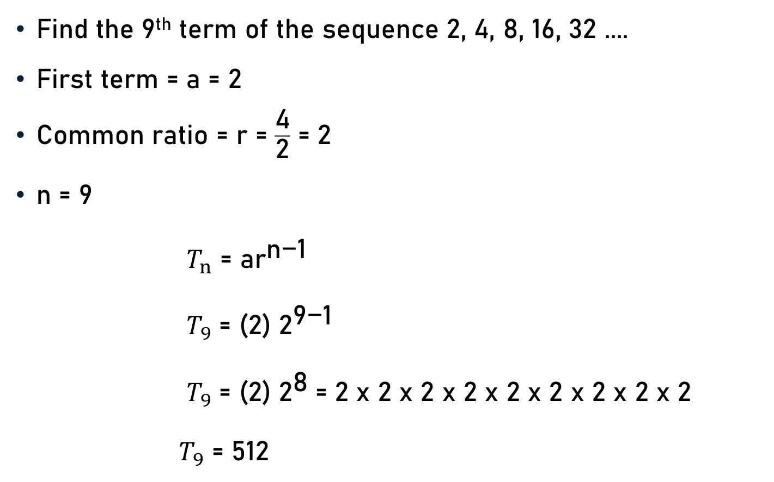
Problem 10
Find the 9th term of the sequence 2, 4, 8, 16, 32 ....
First term = a = 2
Common ratio = r = $\frac{\text{4}}{\text{2}}$ = 2
n = 9
$T_{n}$ = a${\text{r}}^{\text{n}\text{−1}}$
$T_{9}$ = (2) ${\text{2}}^{\text{9}\text{−1}}$
$T_{9}$ = (2) ${\text{2}}^{\text{8}}$= 2 x 2 x 2 x 2 x 2 x 2 x 2 x 2 x 2
$T_{9}$ = 512

Slide 14

Problem 11
Find the sum of 7 terms of the series $\frac{\text{1}}{\text{4}}$ + $\frac{\text{1}}{\text{2}}$ + 1 ……...
a = $\frac{\text{1}}{\text{4}}$, r = $\frac{\frac{\text{1}}{\text{2}}}{\frac{\text{1}}{\text{4}}} \text{or}\frac{\text{1}}{ \frac{\text{1}}{\text{2}}}$ = 2 (> 1), and n = 7
$S_{n}$ = $\frac{\text{a}\text{(}{\text{r}}^{\text{n}} \text{− 1)}}{\text{(}\text{r}\text{ − 1)}}$ = $\frac{\frac{\text{1}}{\text{4}}\text{(}{\text{2}}^{\text{7}} \text{− 1)}}{\text{(}\text{2}\text{ − 1)}}$
$S_{n}$ = $\frac{\frac{\text{1}}{\text{4}}\text{(}\text{1}\text{2}\text{8}\text{− 1)}}{\text{ 1}}$
$S_{n}$ = $\frac{\text{127}}{\text{4}}$

Slide 15
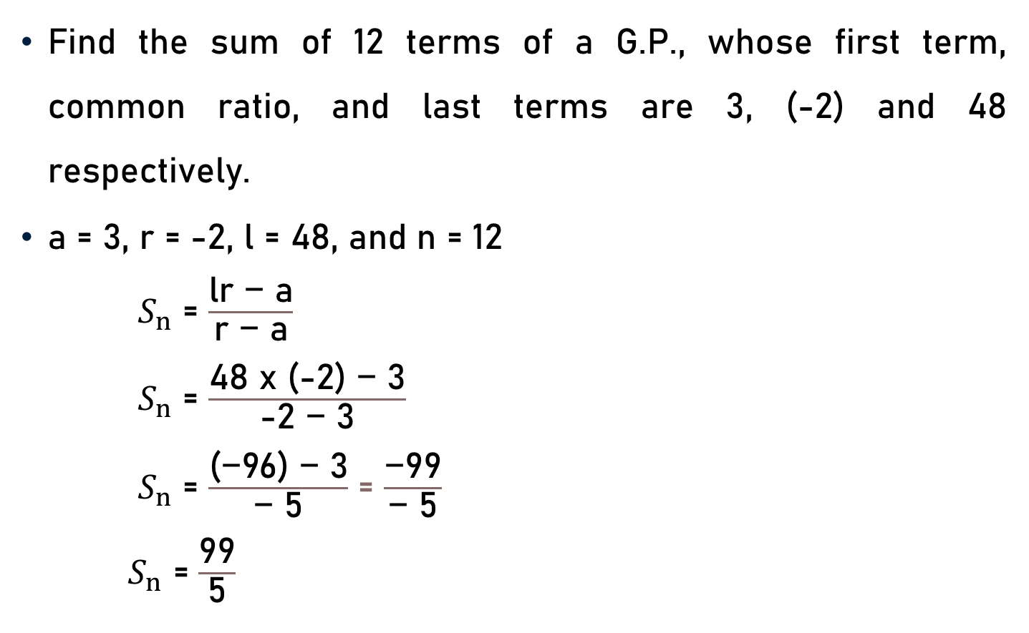
Problem 12
Find the sum of 12 terms of a G.P., whose first term, common ratio, and last terms are 3, (-2) and 48 respectively.
a = 3, r = -2, l = 48, and n = 12
$S_{n}$ = $\frac{\text{lr}\text{ − }\text{a}}{\text{r}\text{ − }\text{a}}$
$S_{n}$ = $\frac{\text{48 }\text{x}\text{ (−2) − 3}}{\text{−2}\text{ − }\text{3}}$
$S_{n}$ = $\frac{\text{(−96) − 3}}{\text{− 5}}$ = $\frac{\text{−99}}{\text{− 5}}$
$S_{n}$ = $\frac{\text{99}}{\text{5}}$

Slide 16
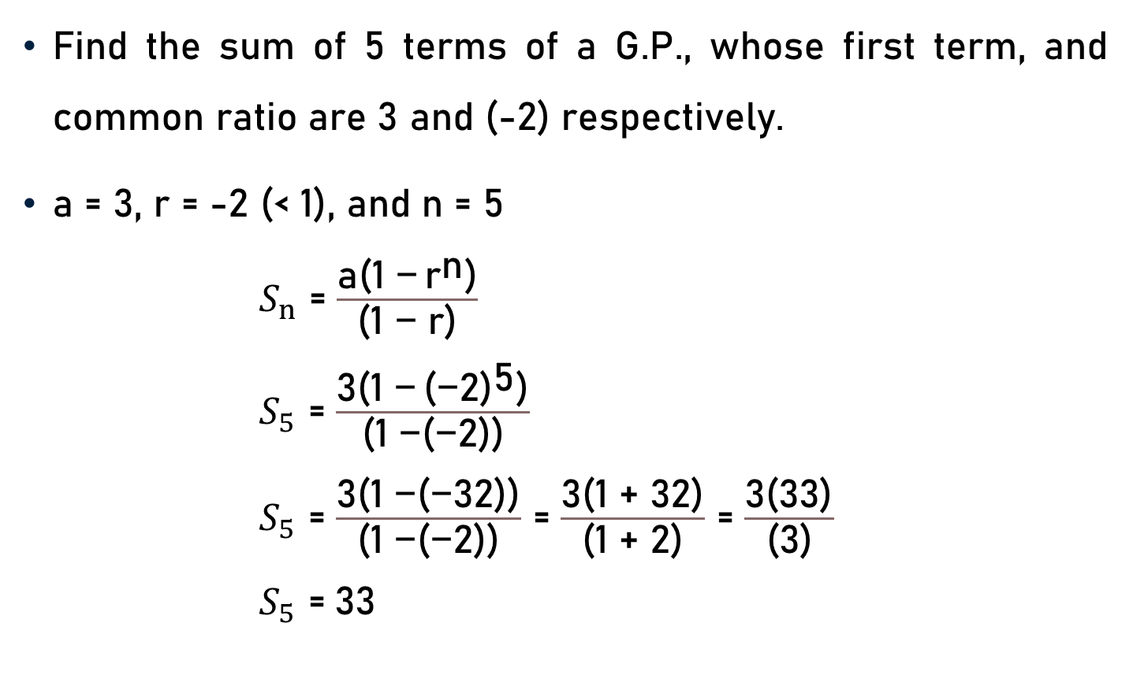
Problem 13
Find the sum of 5 terms of a G.P., whose first term, and common ratio are 3 and (-2) respectively.
a = 3, r = -2 (< 1), and n = 5
$S_{n}$ = $\frac{\text{a}\text{(1 −} {\text{r}}^{\text{n}}\text{)}}{\text{(1 − }\text{r}\text{)}}$
$S_{5}$ = $\frac{\text{3}\text{(1 −} {\text{(}\text{−}\text{2)}}^{\text{5}}\text{)}}{\text{(1 −(−2))}}$
$S_{5}$ = $\frac{\text{3(1 −(−}\text{3}\text{2))}}{\text{(1 }\text{−(−}\text{2))}}$ = $\frac{\text{3(1 }\text{+ }\text{32)}}{\text{(1 }\text{+ }\text{2)}}$ = $\frac{\text{3(}\text{33}\text{)}}{\text{(}\text{3}\text{)}}$
$S_{5}$ =$\text{33}$

Slide 17
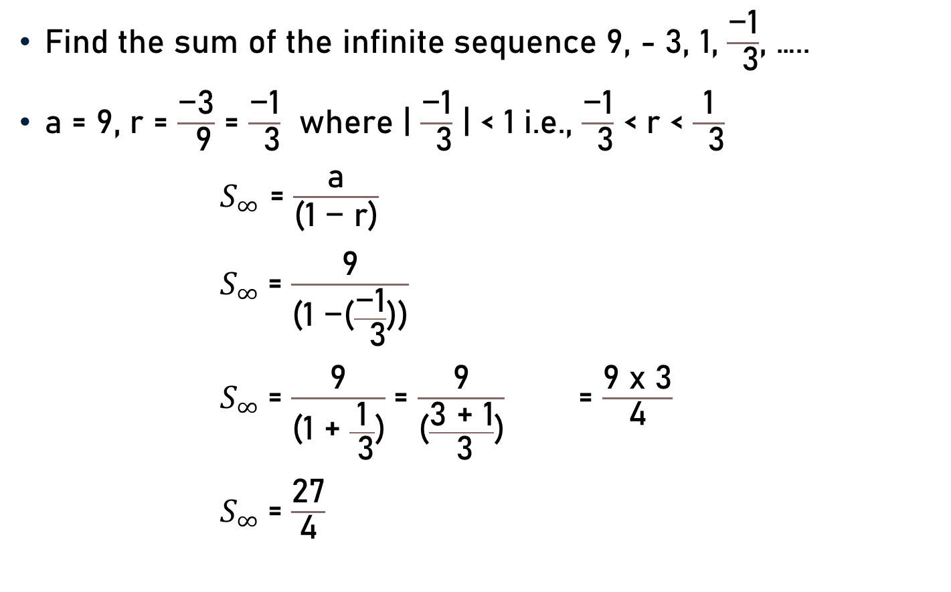
Problem 14
Find the sum of the infinite sequence 9, - 3, 1, $\frac{\text{−}\text{1}}{ \text{3}}$, …..
a = 9, r = $\frac{\text{−}\text{3}}{ \text{9}}$ = $\frac{\text{−1}}{ \text{3}}$ where | $\frac{\text{−1}}{ \text{3}}$ | < 1 i.e., $\frac{\text{−1}}{ \text{3}}$ < r < $\frac{\text{1}}{ \text{3}}$
$S_{∞}$ = $\frac{\text{a}}{\text{(1 − }\text{r}\text{)}}$
$S_{∞}$= $\frac{\text{9}}{\text{(1 −(}\frac{\text{−1}}{ \text{3}}\text{))}}$
$S_{∞}$= $\frac{\text{9}}{\text{(1 }\text{+ }\frac{\text{1}}{ \text{3}}\text{)}}$ = $\frac{\text{9}}{\text{(}\frac{\text{3}\text{ +} \text{1}}{ \text{3}}\text{)}}$ = $\frac{\text{9} \text{x}\text{ 3}}{\text{4}}$
$S_{∞}$= $\frac{\text{27}}{\text{4}}$
3

Slide 18
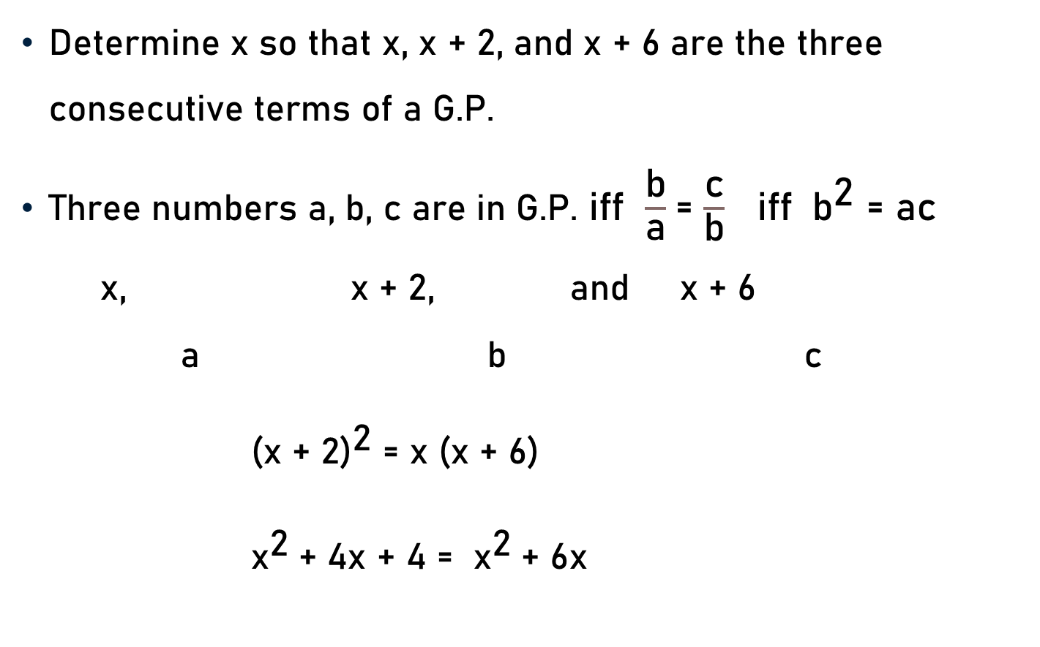
Problem 15
Determine x so that x, x + 2, and x + 6 are the three consecutive terms of a G.P.
Three numbers a, b, c are in G.P. iff $\frac{\text{b}}{\text{a}}$= $\frac{\text{c}}{\text{b}}$ iff ${ \text{b}}^{\text{2}}$ = ac
x, x + 2, and x + 6
a b c
${\text{(}\text{x}\text{ + 2}\text{)}}^{\text{2}}$ = x (x + 6)
${\text{x}}^{\text{2}}$+ 4x + 4 = ${\text{x}}^{\text{2}}$+ 6x

Slide 19

Problem 15
${\text{x}}^{\text{2}}$+ 4x + 4 = ${\text{x}}^{\text{2}}$+ 6x
4 = 6x – 4x
2x = 4
x = 2
Three consecutive terms are x, x + 2, and x + 6
i.e., 2, 2 + 2, and 2 + 6
i.e., 2, 4, and 8
2

Slide 20
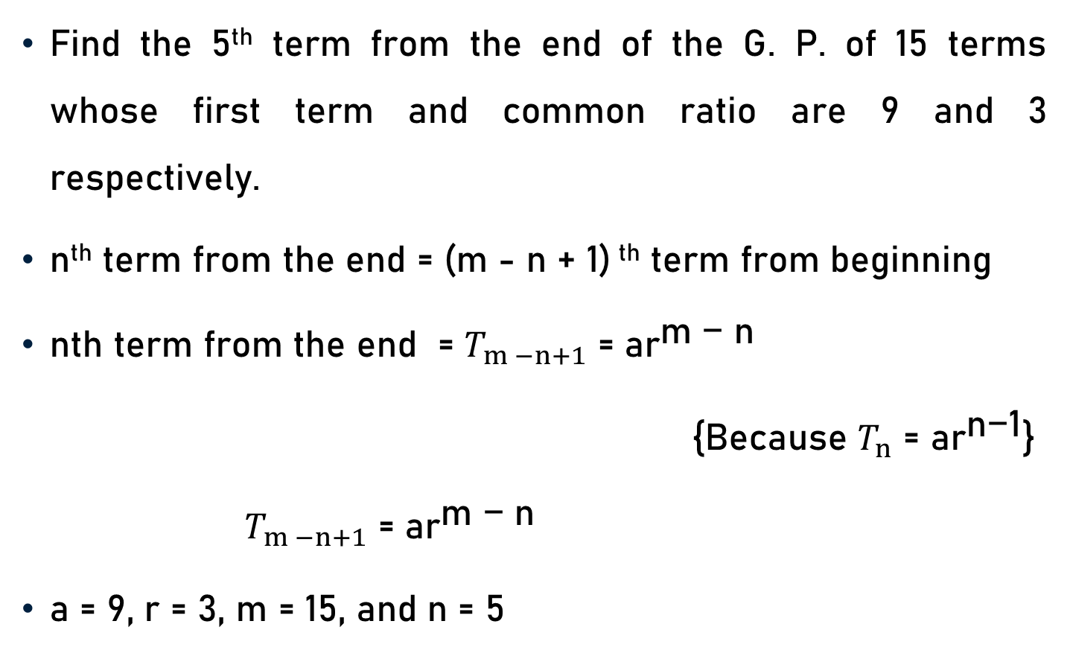
Problem 16
Find the 5th term from the end of the G. P. of 15 terms whose first term and common ratio are 9 and 3 respectively.
n^{th} term from the end = (m - n + 1) ^{th} term from beginning
nth term from the end = $T_{m −n+1}$ = a${\text{r}}^{\text{m}\text{ − }\text{n}}$
{Because $T_{n}$ = a${\text{r}}^{\text{n}\text{−1}}$}
$T_{m −n+1}$ = a${\text{r}}^{\text{m}\text{ − }\text{n}}$
a = 9, r = 3, m = 15, and n = 5

Slide 21

Problem 16
$T_{m −n+1}$ = a${\text{r}}^{\text{m}\text{ − }\text{n}}$
a = 9, r = 3, m = 15, and n = 5
$T_{15 −5+1}$ = 9${ \text{x}\text{ (3)}}^{\text{15}\text{ − }\text{5}}$
$T_{11}$ = 9${ \text{x}\text{ (3)}}^{\text{1}\text{0}}$
$T_{11}$ = 9 x 59049 or ${ \text{(3)}}^{\text{2}} { \text{x}\text{ (3)}}^{\text{10}}$
$T_{11}$ = 531441 or ${ \text{(3)}}^{\text{1}\text{2}}$

Slide 22
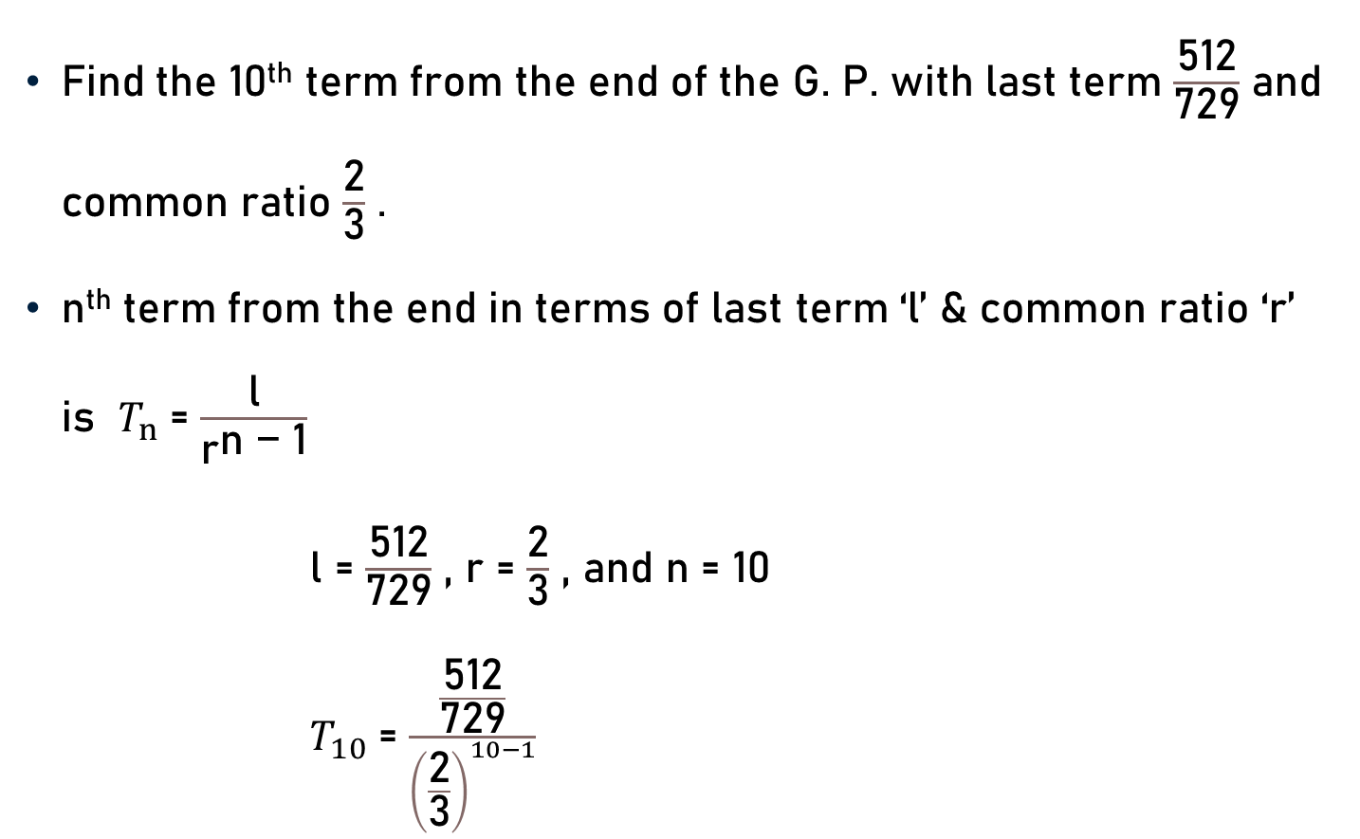
Problem 17
Find the 10th term from the end of the G. P. with last term $\frac{\text{512}}{\text{729}}$ and common ratio $\frac{\text{2}}{\text{3}}$ .
n^{th} term from the end in terms of last term ‘l’ & common ratio ‘r’ is $T_{n}$= $\frac{\text{l}}{{\text{r}}^{\text{n}\text{ − 1}}}$
l = $\frac{\text{512}}{\text{729}}$ , r = $\frac{\text{2}}{\text{3}}$ , and n = 10
$T_{10}$= $\frac{\frac{\text{512}}{\text{729}}}{{\left(\frac{\text{2}}{\text{3}}\right)}^{10−1}}$

Slide 23

Problem 17
l = $\frac{\text{512}}{\text{729}}$ , r = $\frac{\text{2}}{\text{3}}$ , and n = 10
$T_{10}$= $\frac{\frac{\text{512}}{\text{729}}}{{\left(\frac{\text{2}}{\text{3}}\right)}^{10−1}}$ = $\frac{\frac{{ \left(\text{2}\right)}^{9}}{{\left(\text{3}\right)}^{6}}}{\frac{{ \left(\text{2}\right)}^{9}}{{\left(\text{3}\right)}^{9}}}$
$T_{10}$=$\frac{{ \left(\text{2}\right)}^{9 − 9}}{{\left(\text{3}\right)}^{6 − 9}} \text{=}\frac{{ \left(\text{2}\right)}^{0}}{{\left(\text{3}\right)}^{− 3}}$
$T_{10}$= 1 x ${\left(\text{3}\right)}^{3}$
$T_{10}$= 27

Slide 24
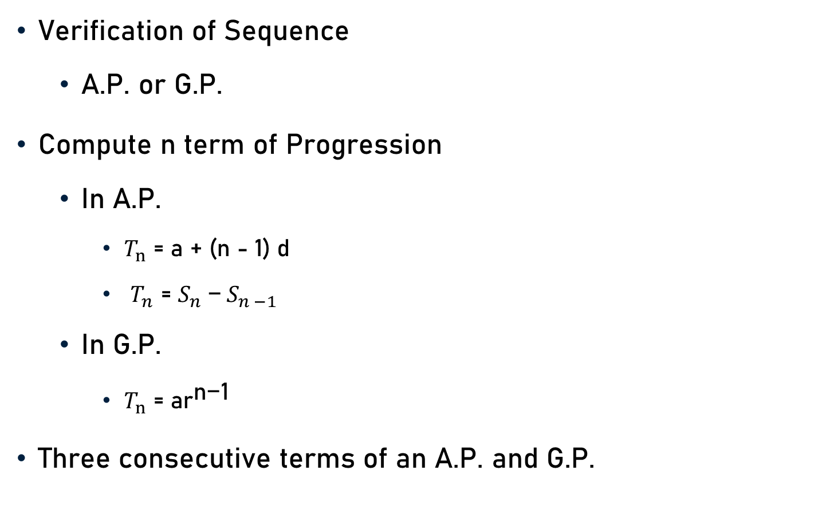
Conclusion
Verification of Sequence
  A.P. or G.P.
Compute n term of Progression
  In A.P.
    $T_{n}$ = a + (n - 1) d
    $T_{n}\text{ = }S_{n} \text{−}{ S}_{n −1}$
  In G.P.
    $T_{n}$ = a${\text{r}}^{\text{n}\text{−1}}$
Three consecutive terms of an A.P. and G.P.

Slide 25
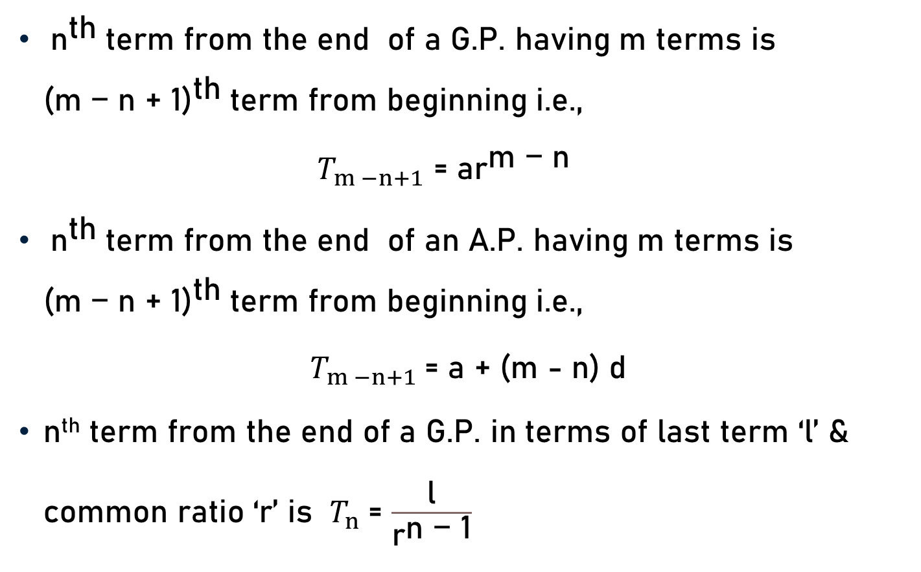
Conclusion
${ \text{n}}^{\text{th}}$term from the end of a G.P. having m terms is ${\text{(}\text{m}\text{ − }\text{n}\text{ + 1)}}^{\text{th}}$term from beginning i.e.,
$T_{m −n+1}$ = a${\text{r}}^{\text{m}\text{ − }\text{n}}$
${ \text{n}}^{\text{th}}$term from the end of an A.P. having m terms is ${\text{(}\text{m}\text{ − }\text{n}\text{ + 1)}}^{\text{th}}$term from beginning i.e.,
$T_{m −n+1}$= a + (m - n) d
n^{th} term from the end of a G.P. in terms of last term ‘l’ & common ratio ‘r’ is $T_{n}$= $\frac{\text{l}}{{\text{r}}^{\text{n}\text{ − 1}}}$

Slide 26

Conclusion
Sum of n terms of A.P.
  $S_{n}$ = $\frac{\text{n}}{\text{2}}${2a + (n - 1) d}
  $S_{n}$ = $\frac{\text{n}}{\text{2}}${a + l}
  $S_{n}$ = $\frac{\text{n}}{\text{2}}$ [2l - (n - 1) d]

Slide 27

Conclusion
Sum of n terms of G.P.
  $S_{n}$ = $\frac{\text{lr}\text{ − }\text{a}}{\text{r}\text{ − }\text{a}}$
  $S_{n}$ = $\frac{\text{a}\text{(}{\text{r}}^{\text{n}} \text{− 1)}}{\text{(}\text{r}\text{ − 1)}}$ when r > 1
  $S_{n}$ = $\frac{\text{a}\text{(1 −} {\text{r}}^{\text{n}}\text{)}}{\text{(1 − }\text{r}\text{)}}$ when r < 1
Sum of infinite terms of G.P.
    $S_{∞}$ = $\frac{\text{a}}{\text{(1 − }\text{r}\text{)}}$ when | r | < 1 i.e., - 1 < r < 1

Slide 28
Summary
Problems
  Arithmetic Progression
  Geometric Progression

